Slide 1
Comprehensive First Aid
Thermometer x 1
Hydrocolloid Dressing 10cm x 10cm x 1
Burn Dressing 10cm x 1
Burn Blot 3.5g x 3
Paraffin Gauze Dressings x 2
Gauze swabs 5’s x 1
Sterile Wound Wipes 10’s x 1
Non Adherent Wound Pad 5cm x 10
Non Adherent Wound Pad 10cm x 5
Adherent Wound Pads x 6
Micropore Tape 2.5cm x 1
Wound Dressing No 14 and No 15 x 1 each
Plaster Pack Standard
Cotton Wool 25g
Fabric and Waterproof Plaster Strips x 1 each
Crepe Bandage 7.5cm
Safety Pins
Scissors, Tweezers
Triangular Bandage
Tubigrip size E x 1
Disposable Gloves x 5
Tisept Antiseptic Wash x 2
Zinc Oxide 1.5cm x 1
Povidone Iodine 100ml x 1 (not in kit)

Slide 2
2 angles of the tweezers – not so easy to photograph

Slide 3
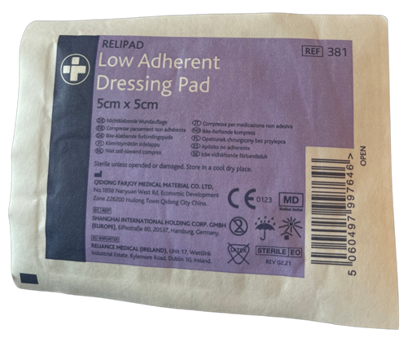
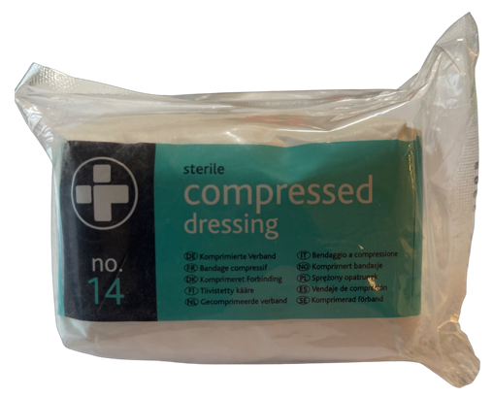
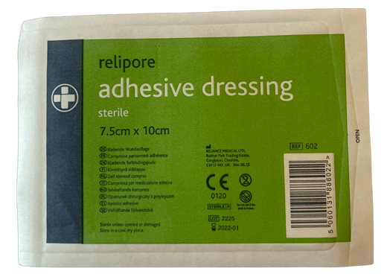

Slide 4
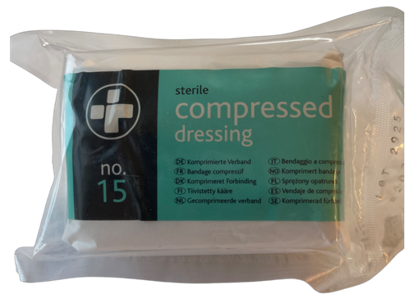
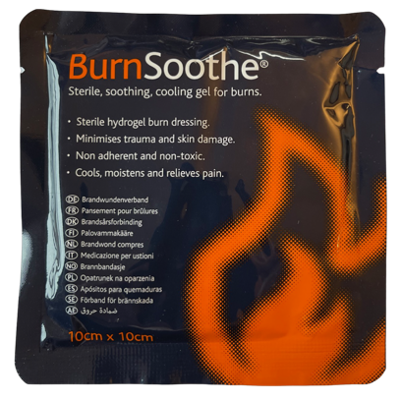
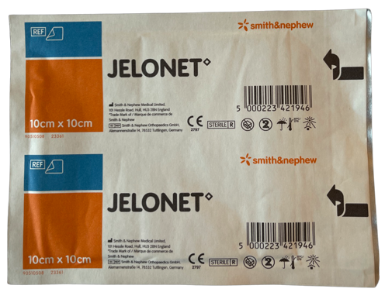

Slide 5
